Slide 1
Binary Trees
Chapter 6

Slide 2
Objectives
Trees, Binary Trees, and Binary Search Trees
Tree Traversal
Implementing Binary Trees
Binary Search Tree
Insertion
Deletion
Balancing a Tree
The DSW Algorithm (*)
AVL Trees
Heaps
Polish Notation and Expression Trees (*)
Reading at home
Notes:
Note: (*) Means that students are required to understand essential features only (the problem explanation, definitions, the outline of algorithms…), not in details.

Slide 3
Generic term of
tree data structure

Slide 4
What is a tree?
A tree is an abstract model of a hierarchical structure
A tree consists of nodes with parent-child relation
Inspiration: family trees
Applications:
Organization charts
File systems
Programming environments
Every node except one (a root) has a unique parent

Slide 5
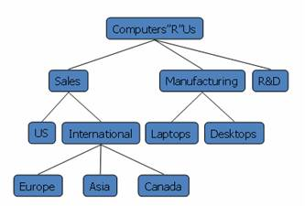
Exact (Formal) definition
Empty structure is an empty tree
Non-empty tree consists of a root and its children, where these children are also trees

Slide 6
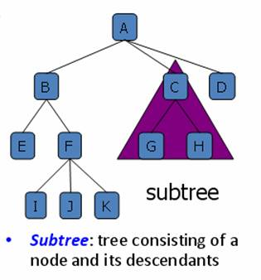
Given a tree

Slide 7
Henry: tree serialization
A tree from a table (reading, loading)
A tree into a table (serializing, saving)
A tree with indentation(dash/tab)

Slide 8
Tree Terminologies
Root: unique node without a parent
Internal node: node with at least one child (A, B, C, F)
Leaf: node without children (E, I, J, K, G, H, D)
Ancestors: parent, grandparent, great-grand-parent, …
Descendants: child, grandchild, great-grandchild, etc.
Level: a root is at level 1 (sometimes 0).
A father is level i then its children are at level i+1
Height: maximum level in a tree
Empty tree is a legitimate tree of height 0 (by definition)
A single node is a tree of height 1
Degree (order): number of its children
Each node has to be reachable from the root through a unique sequence of arcs, called path.
The number of arcs in a path is called the length of the path.

Slide 9
Henry: tree and node analogy
Head (list) ~ root (tree)
Tail (list) ~ leaf (tree)
Just single tail in list
Many leaves in tree though
You can have the list of leaves (current active tails)
Previous (list) ~ parent (tree)
A node with parent/previous provides the ability to go back, but it is costly
A root node has no previous/parent

Slide 10
head
mid
tail
previous
previous
previous
previous
previous
mid1
leaf 1
root
previous
previous
leaf 2
previous
mid2
leaf 3
previous

Slide 11
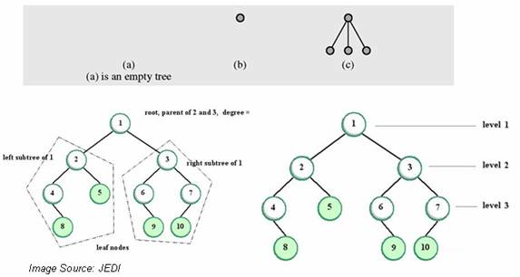
Tree examples

Slide 12
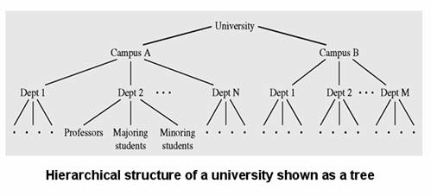
Tree examples

Slide 13
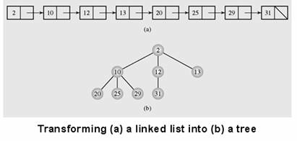
Linked List to Tree Conversion
Linked List can be converted into orderly tree
All elements are stored according to some order
However, from searching point of view, it is not better than a linked list (if it doesn’t consist some additional constraints regarding arrangement of nodes)

Slide 14
Definition, Types, Traversal
Binary Tree

Slide 15
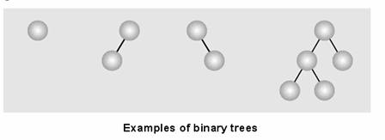
Binary Trees
Binary tree: each node has at most two children
Empty tree is a binary tree
Each child may be empty or designated as either left child or right child

Slide 16
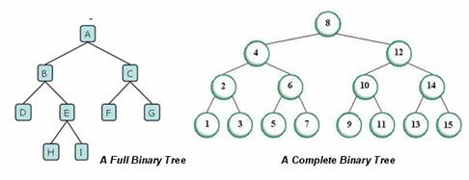
Types of Binary Trees
Full binary tree (sometimes proper binary tree or 2-tree): every node other than the leaves has two children
Complete binary tree: all non-terminal nodes have both children, and all leaves are at the same level

Slide 17
Tree Traversal
Tree traversal:
Process of visiting each node in the tree exactly one time
Breadth-first traversal:
Visiting each node starting from lowest (or highest) level and moving down (or up) level by level
Visiting nodes on each level from left to right (or from right to left)
Recursive version
Stack-based version

Slide 18
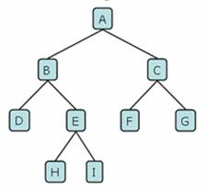
Breadth-first Tree traversal example
Same level first
Using queue
Bread-first traversal:
A, B, C, D, E, F, G, H, I

Slide 19
Henry
Breadth-first can avoid infinite branch
We can stop at certain level

Slide 20
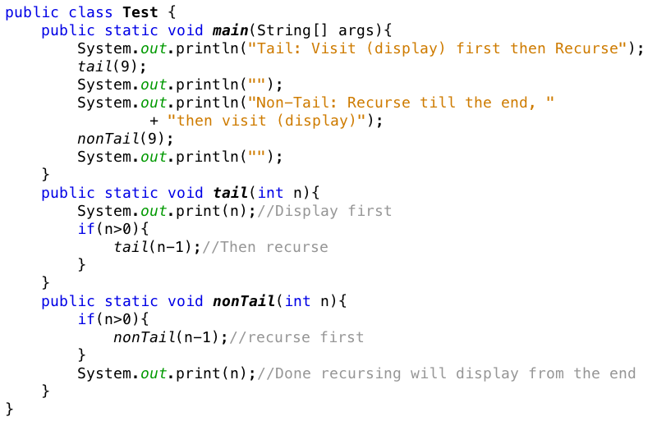
Tutorial: visit first or recursive call first

Slide 21
Tree traversal (2)
Depth-first traversal:
Proceeds as far as possible to the left (or right)
Then backs up until the first crossroad
Goes one step to the right (or left)
Again, as far as possible to the left (or right)
There are three tasks to be done:
V: Visiting a node
L: Traversing the left subtree
R: Traversing the right subtree

Slide 22
Ways of depth-first traversal
Three tasks can be ordered in 3!=6 ways
There are 6 possible ordered depth-first traversals
It can be reduced to 3 traversals
The move is always from left to right and
Attention is focused on the first column.
The 3 traversals are given these standard names
VLR: Preorder traversal (or NLR)
LVR: Inorder traversal (or LNR)
LRV: Postorder (or LRN)
Notes:
Left Node Right

Slide 23
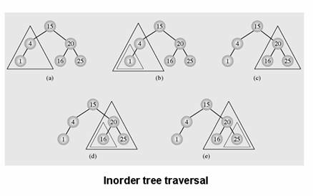
Inorder tree traversal

Slide 24
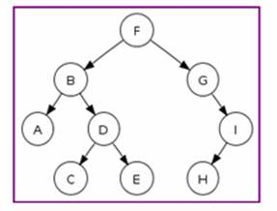
Tree Traversal Example
Preorder traversal: F, B, A, D, C, E, G, I, H (root, left, right)
Inorder traversal: A, B, C, D, E, F, G, H, I (left, root, right)
Postorder traversal: A, C, E, D, B, H, I, G, F (left, right, root)
Level-order traversal (breadth-first): F, B, G, A, D, I, C, E, H

Slide 25
Binary Tree
Implementation

Slide 26
Array - Binary tree implementation
Binary trees can be implemented at least in two ways
As arrays
As linked structures
To implement tree as an array
A node is declared as an object with
Information field and
Two reference fields
These reference fields contain the indexes of the array cells in which the left and the right children are stored, if any.
It is hard to predict how many nodes will be created during program execution
How to reserve spaces and know the size to define an array?

Slide 27
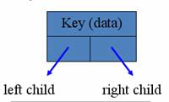
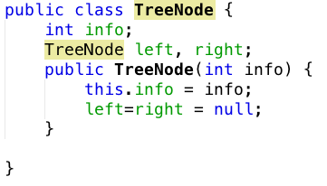
Linked - Binary tree implementation
Linked structure implementation
A node is declared as an object with
Information field and
Two reference fields

Slide 28
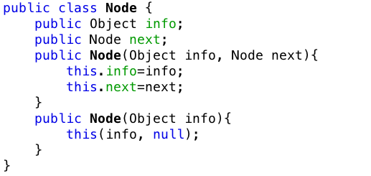
Demo – Build Queue First – Queue Node

Slide 29
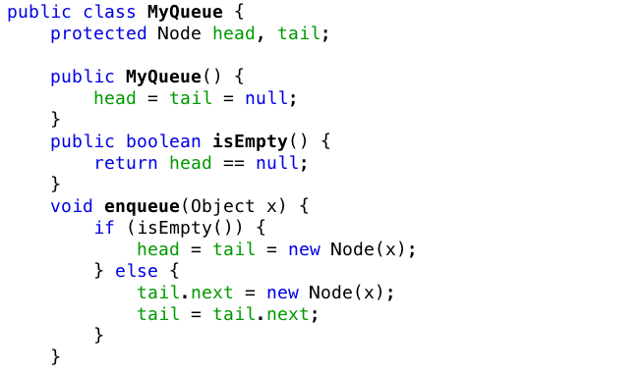
MyQueue

Slide 30
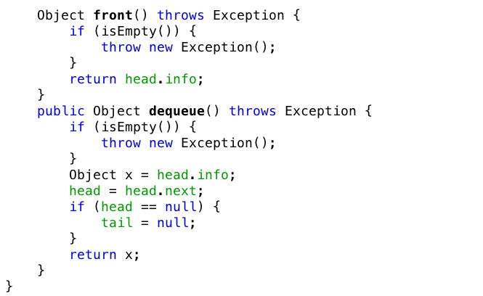
MyQueue

Slide 31
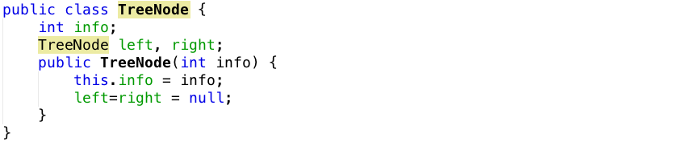
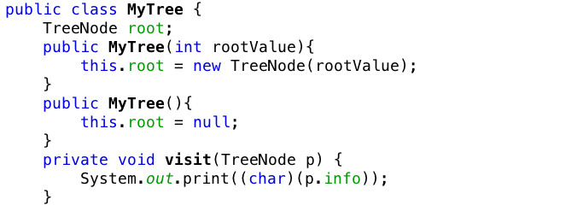
Tree Implementation

Slide 32
Breadth-first Algorithm
Put the root node into the queue
Repeat following steps (till no more node in the queue to process)
Dequeue the node from the queue
Put its children (if there’s) into the queue
Display value of the node
F
Output:

Slide 33
Breadth-first Algorithm
Put the root node into the queue
Repeat following steps (till no more node in the queue to process)
Dequeue the node from the queue
Put its children (if there’s) into the queue
Display value of the node
F
Output:

Slide 34
Breadth-first Algorithm
Put the root node into the queue
Repeat following steps (till no more node in the queue to process)
Dequeue the node from the queue
Put its children (if there’s) into the queue
Display value of the node
B
G
Output:
F
F

Slide 35
Breadth-first Algorithm
Put the root node into the queue
Repeat following steps (till no more node in the queue to process)
Dequeue the node from the queue
Put its children (if there’s) into the queue
Display value of the node
B
G
Output:
F

Slide 36
Breadth-first Algorithm
Put the root node into the queue
Repeat following steps (till no more node in the queue to process)
Dequeue the node from the queue
Put its children (if there’s) into the queue
Display value of the node
G
A
D
Output:
F
B

Slide 37
Breadth-first Algorithm
Put the root node into the queue
Repeat following steps (till no more node in the queue to process)
Dequeue the node from the queue
Put its children (if there’s) into the queue
Display value of the node
G
A
D
Output:
FB
B
So on and so forth

Slide 38
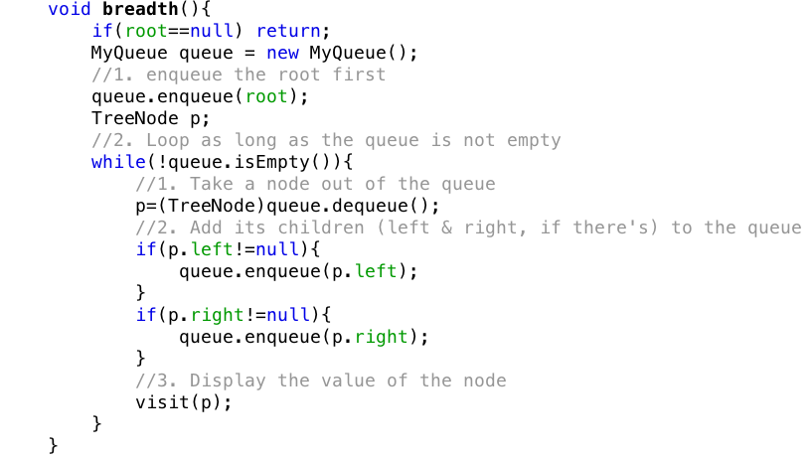
Breadth-first traversal

Slide 39
Depth first
There are three cases:
Pre-order: VLR (Visit – Left – Right), means at every node try to visit first (display the node first) then go its left subtree then its right subtree
In-order: LVR (Left – Visit – Right), means at every node try to go to the left subtree first, if at a node cannot go any further left then visit (display the node), then try to go to the right subtree.
Post-order: LRV (Left – Right – Visit), means at every node try to go all the way to left first, when at a node, cannot go left any further, then try to go right, if at a node cannot go left or right any further, then display the node.

Slide 40
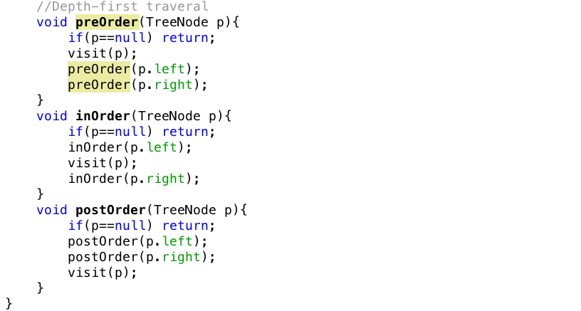
Depth first

Slide 41
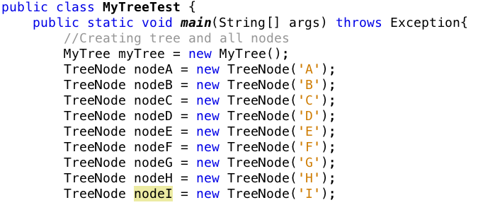
Test program

Slide 42
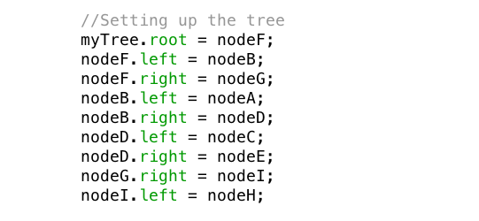
Setting up the tree

Slide 43
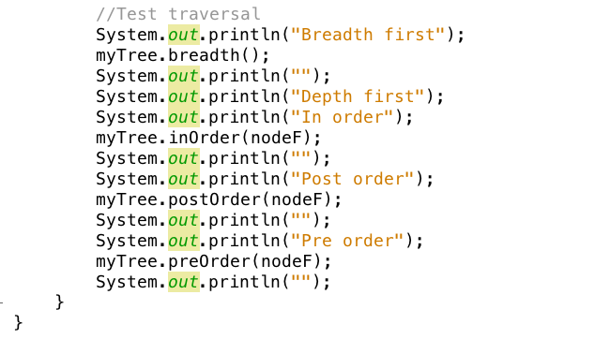
Traverse the tree

Slide 44
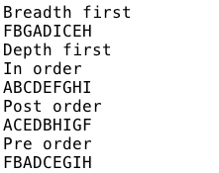
Output

Slide 45
Binary Search Trees

Slide 46
Binary Search Tree Definition
Binary Search Tree is a node based tree data structure which has following properties
Left subtree of a node contains only nodes with keys less than the node’s key
Right subtree of a node contains only nodes with keys greater than the node’s key
Both the left and right subtrees must also be binary search trees
From above definition, it’s naturally follows that
Each node has a distinct key (no equal)
An inorder traversal of a binary search tree visits the keys in increasing order

Slide 47
Henry: the partitioning properties
The BST partitions the search space into two subspaces (recursively)
Shorter trees is more efficient. Tall tree => slow search
Whatever you do (add, remove), do not break the partitioning property of the tree. Otherwise you cannot search

Slide 48
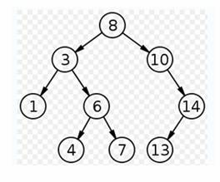
Binary search tree example
Insertion
Deletion
Search
(Contain)

Slide 49
Insertion on Binary Search Tree
4
20
15
15
15
null
4
19
17
15
15
15
4
20
4
20
4
20
17
17
19

Slide 50
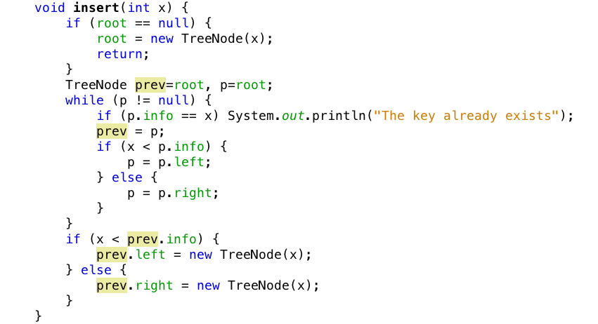
Insertion on a Binary Search Tree
Don't break the ordering property of the tree

Slide 51
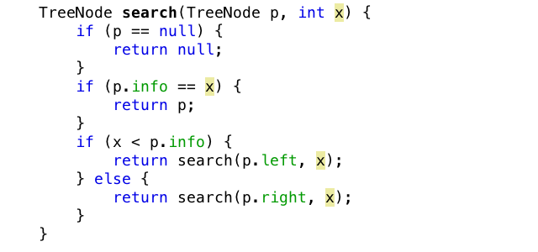
Searching on Binary Search Trees

Slide 52
Henry: tree types
Generic tree
Binary Tree
Shortest
Binary Search Tree
(AVL tree)
Binary Search Tree
N children to 2 children
Ordering property
Shortest

